Slide 1
Quarterly Macro-Fiscal Model (QMFM)
Prepared by Modelling Team, Macro DG.
May 24, 2023

Slide 2
1. Key model features
The model is based on the standard FPAS approach as used by many CB and some MoF, with the four main blocks, and some additional features common to many recent FPAS.
IS demand curve determining output gap, including the effect of fiscal policies on macro indicators;
Phillips curves (core, food, and energy, as per official CPI components), with trends in relative prices;
hybrid ER rule driven by (i) domestic - foreign interest rate differentials (UIP); and (ii) target ER driven by trend RER rate change and domestic ─ foreign inflation differential;
(modified Taylor) interest rate rule, responding to expected inflation deviation and the output gap, and allowing for a response to a deviation of the ER change from targeted ER change;

Slide 3
Novel features
final demand (FD) components in output; --(private) Consumption, Investment, Government demand, Export, and Import gaps (the latter from FD import shares)—modified IS block
incorporating fiscal variables—structural, cyclical and discretionary components in govt revenue and expenditure—allowing simulating fiscal policies and facilitating coordination with monetary policies—fiscal block with partially endogenous fiscal policies
tracing financing of govt deficit (grants, domestic/foreign borrowing), debt stocks and interest payments (for target sustainable debt/GDP)—financing/debt auxiliary variables
incorporating monetary and BOP equations (money demand, net public borrowing, private capital flows,..) which do not feedback into main model—financial flow auxiliary variables
deriving key macro variables in levels, for comparison with other projection models (esp. intMF). The QMFM database is drawn from intMF, its source files, and WEOGAS/GEE as used for intMF projections
---imposes consistency on macro-data between NA, BOP, and Fiscal (ex. resource balance, govt financing flows, govt consumption,…) and fiscal and govt debt data
specific other features: distinguishing a lending rate premium above the IB rate; having non-linearity because most fiscal variables are in percent of GDP.

Slide 4
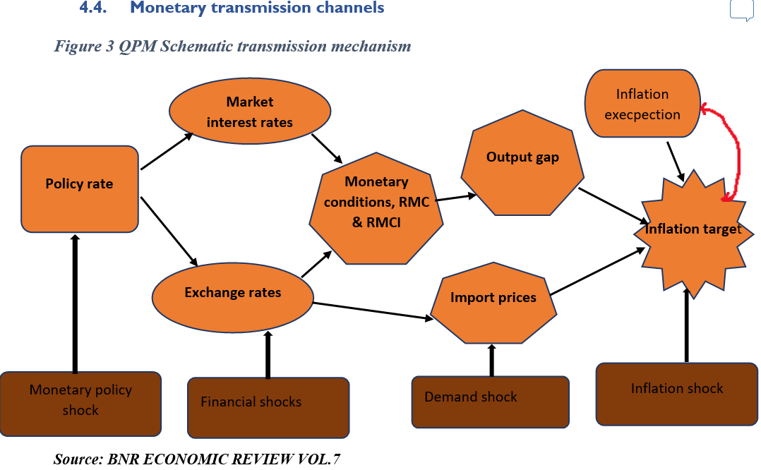
Standard

Slide 5
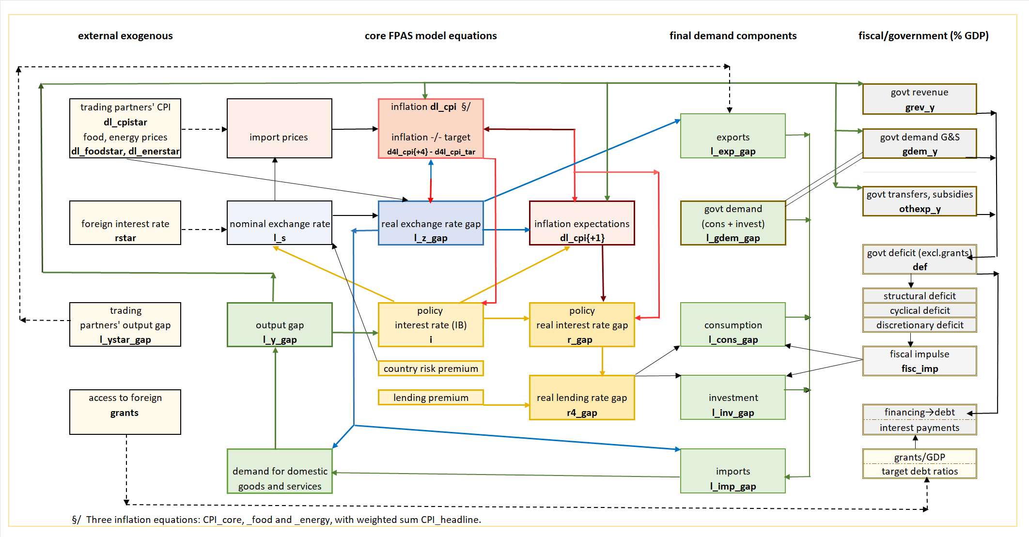
2. Main relationships and transmission mechanisms in QMFM

Slide 6
Fiscal transmission mechanisms
In addition to standard interest, exchange rates and expectations channels;
directly: government demand for G&S affects output directly as one of the aggregate demands determining output (modified IS curve)
indirectly: discretionary deficit (from govt demand for G&S, transfers/subsidies, and non/tax revenue) indirectly co-determines fiscal impulse which affects private consumption and investment.
The latter two discretionary deficit components affect disposable income and hence demand; the first component affects agents’ optimism and hence demand
change in the structural deficit is the other determinant of the fiscal impulse
cyclical deficit counteracts the business cycle by raising govt demand for G&S and raising incomes through transfers/subsidies and lower effective govt revenue collection in a downturn (and v.v. in an upturn).

Slide 7
2. Model blocks
Fiscal policy
Deficit
def = def_str + def_cyc + def_discr
Structural
def_str = d4⟨0.95⟩ * def_str{-1} + (1 - d4⟨0.95⟩) * (ss_bor_str⟨6⟩ + ss_grants⟨5⟩) + d6⟨0.02⟩ * (dl_gdem_tnd - dl_y_tnd) + shock_def_str⟨σ= 0.3⟩
Cyclical
def_cyc = - d1⟨0.3⟩ * l_y_gap;
Discretional
def_discr = d2⟨0⟩ * def_discr{-1} + d5⟨1⟩ * w_y_gdem⟨0.23⟩ * l_gdem_gap + shock_def_discr⟨σ= 3⟩
Fiscal impulse (discr+str)
fisc_imp = def_discr + (def_str - def_str{-1})

Slide 8
Final Demand
Agg. Output gap
l_y_gap = w_y_cons ⟨ 0 .78 ⟩ * l_cons_gap + w_y_inv ⟨ 0 .13 ⟩ * l_inv_gap + w_y_gdem ⟨ 0 .23 ⟩ * l_gdem_gap + w_y_exp ⟨ 0 .21 ⟩ * l_exp_gap - w_y_imp ⟨ 0 .35 ⟩ * l_imp_gap + shock_l_y_gap ⟨ σ= 0 .0001 ⟩
Consumption
l_cons_gap = a1_cons ⟨0.65⟩ * l_cons_gap{-1} + a2_cons⟨0⟩ * e_l_cons_gap + a3_cons⟨0.1⟩ * rmci_cons + a4_cons⟨0.2⟩ * l_y_gap + a5_cons⟨0.25⟩ * fisc_imp + shock_l_cons_gap⟨σ= 2.5⟩
rmci_cons = a6_cons ⟨ 1 ⟩ * r4_gap + (1 - a6_cons ⟨ 1 ⟩) * - l_z_gap
Investment
l_inv_gap = a1_inv ⟨ 0 .65 ⟩ * l_inv_gap {-1} + a2_inv ⟨ 0 ⟩ * e_l_inv_gap - a3_inv ⟨ 0 . 1 ⟩ * rmci_inv + a4_inv ⟨ 0 . 2 ⟩ * l_y_gap + a5_inv ⟨ 0 .15 ⟩ * fisc_imp + shock_l_inv_gap ⟨ σ= 6 ⟩ rmci
Export
l_exp_gap = a1_exp ⟨ 0 .65 ⟩ * l_exp_gap{-1} + a2_exp ⟨ 0 ⟩ * e_l_exp_gap - a3_exp ⟨ 0 . 2 ⟩ * rmci_exp + a5_exp ⟨ 0 . 3 ⟩ * l_ystar_gap + shock_l_exp_gap ⟨ σ= 6 ⟩
Import
l_imp_gap = w_imp_cons ⟨0 .445714⟩ * l_cons_gap + w_imp_inv ⟨0 .156⟩ * l_inv_gap + w_imp_gdem ⟨0 .276⟩ * l_gdem_gap + w_imp_exp ⟨ 0 .122286⟩ * l_exp_gap - a1_imp ⟨ 0 . 3⟩ * l_z_gap + shock_l_imp_gap ⟨ σ= 0 . 5 ⟩ ;
Govt demand
l_gdem_gap = a1_gdem ⟨ 0.65⟩ * l_gdem_gap{-1} + shock_l_gdem_gap ⟨ σ= 6 ⟩;

Slide 9
Prices
Headline
l_cpi = w_core⟨0.7747⟩ * l_cpi_core + w_food⟨0.1577⟩ * l_cpi_food + w_ener⟨0.0676⟩ * l_cpi_ener + shock_l_cpi⟨σ= 0.0001⟩
Core
dl_cpi_core = b1⟨0.45⟩ * dl_cpi_core{-1} + (1 - b1⟨0.45⟩ - b3⟨0.05⟩) * (e_dl_cpi_core) + b3⟨0.05⟩ * dl_cpi_core_direct + b2⟨0.2⟩ * rmc + shock_dl_cpi_core⟨σ= 2⟩
Food
dl_cpi_food = bf1⟨0.35⟩ * dl_cpi_food{-1} + (1 - bf1⟨0.35⟩ - bf3⟨0.1⟩) * (e_dl_cpi_food) + bf3⟨0.1⟩ * dl_cpi_food_direct + bf2⟨0.1⟩ * (l_rp_foodstar_gap + l_z_gap + l_rp_cpi_core_gap - l_rp_cpi_food_gap) - bf4⟨1.5⟩ * l_y_agr_gap + shock_dl_cpi_food⟨σ= 9⟩
Energy
dl_cpi_ener = be1⟨0.25⟩ * dl_cpi_ener{-1} + (1 - be1⟨0.25⟩ - be3⟨0.02⟩) * (e_dl_cpi_ener) + be3⟨0.02⟩ * dl_cpi_ener_direct + be2⟨0.04⟩ * (l_rp_enerstar_gap + l_z_gap + l_rp_cpi_core_gap - l_rp_cpi_ener_gap) + shock_dl_cpi_ener⟨σ= 7.1⟩;

Slide 10
Monetary Policy rule
Interest rate (Inter - bank rate)
i = c1⟨0.8⟩ * i{-1} + (1 - c1⟨0.8⟩) * + i_tnd + c2⟨0.5⟩ * d4l_cpi_dev + c3⟨0.5⟩ * l_y_gap + c4⟨0⟩ * (dl_s - dl_s_tar) + shock_i⟨σ= 1⟩;
Neutral level
i_tnd = r_tnd + d4l_cpi_tar + dl_rp_cpi_core_tnd
d4l_cpi_dev = d4l_cpi{+4} - d4l_cpi_tar
Real interest rate trend
r_tnd = rstar_tnd + prem + e_dl_z_tnd;
Real interest rate –real lending rate gap
r4_gap = (r_gap + r_gap{+1} + r_gap{+2} + r_gap{+3}) / 4 + prem_d_gap

Slide 11
Exchange rate
Nominal exchange rate
l_s = e1⟨0.2⟩ * (e_l_s - (i - istar - prem)/4) + (1 - e1⟨0.2⟩) * (l_s{-1} + dl_s_tar/4) + shock_l_s ⟨σ= 0.35⟩
Expectation
e_l_s = e2⟨0.2⟩ * l_s{+1} + (1 - e2⟨0.2⟩) * (l_s{-1} + 2 * (dl_z_tnd + d4l_cpi_tar + dl_rp_cpi_core_tnd - ss_dl_cpistar⟨1.98026⟩)/4)
Exch. Target
dl_s_tar = e4⟨0⟩ * dl_s_tar{-1} + (1 - e4⟨0⟩) * ( dl_z_tnd + d4l_cpi_tar + dl_rp_cpi_core_tnd - ss_dl_cpistar⟨1.98026⟩ - e5⟨0.3⟩ * d4l_cpi_dev - e6⟨0.85⟩ * l_z_gap ) + shock_dl_s_tar⟨σ= 0.3⟩
Real exchange rate
l_z = l_s + l_cpistar - l_cpi_core
Real exhange rate trend
dl_z_tnd = r_z * dl_z_tnd{-1} + (1 - r_z) * ss_dl_z_tnd + shock_dl_z_tnd

Slide 12
Exogenous block
International and trading partners
Output gap
l_ystar_gap = r_ystar⟨0.94⟩ * l_ystar_gap{-1} + shock_l_ystar_gap⟨σ= 0.25⟩;
Inflation
dl_cpistar = r_cpistar⟨0.8⟩ * dl_cpistar{-1} + (1 - r_cpistar⟨0.8⟩) * ss_dl_cpistar⟨1.98026⟩ + shock_dl_cpistar ⟨σ= 3.8⟩;
Interest rate
istar = r_istar⟨0.8⟩ * istar{-1} + (1 - r_istar⟨0.8⟩) * (ss_rstar_tnd⟨0⟩ + ss_dl_cpistar⟨1.98026⟩) + shock_istar ⟨σ= 0.45⟩;
Real interest rate trend
rstar_tnd = r_rstar_tnd⟨0.9⟩ * rstar_tnd{-1} + (1 - r_rstar_tnd⟨0.9⟩) * ss_rstar_tnd⟨0⟩ + shock_rstar_tnd ⟨σ= 0.5⟩;
Relative Food and energy prices
l_rp_foodstar_gap = r_rp_foodstar_gap⟨0.62⟩ * l_rp_foodstar_gap{-1} + shock_l_rp_foodstar_gap⟨σ= 5.3⟩;
l_rp_enerstar_gap = r_rp_enerstar_gap⟨0.73⟩ * l_rp_enerstar_gap{-1} + shock_l_rp_enerstar_gap⟨σ= 13.9⟩

Slide 13
THANK YOU

